Slide 1


CHECK POINT HARMONY
HIGHEST LEVEL OF SECURITY FOR REMOTE USERS

Slide 2
REMOTE WORK
IS NOW THE NEW WORLD
74%
Plan to enable large-scale remote working permanently
(Gartner)
Notes:
Securing the new ‘work from anywhere’ hybrid environment is a leading priority for enterprises, as 81% have adopted mass remote working, and 74% plan to do so permanently. And for a good reason – organizations’ attack

Slide 3
Remote Employees are more prone to
Unintentional errors
67%
admit to finding workarounds to corporate security policies in order to be more productive
*CyberArk State of Remote Work Study, Dec 2020
Notes:
But this new working culture makes employees more susceptible to cyber threats.
As evidence, according to a recent industry survey among 2,000 remote employees (from across the world), 67% oadmit to finding workarounds to corporate security policies in order to be more productive including sending work documents to personal email addresses, sharing passwords, and installing rogue applications.
And security awareness training doesn’t cut it…according to the same survey, Over half (54%) of the employees said they had received remote-work specific security training, yet:
~70% of them admit to using corporate devices for personal use.
And ~60% o admit that they allow other members of their household to use their corporate devices for activities like schoolwork, gaming and shopping.

Slide 4

50%
increase in the daily average of ransomware attacks worldwide in Q3 2020
Compared to the first half of the year
3,900%
global increase in phishing and malware attacks during the first half of 2020
Hackers take advantage OF THE SITUATION
Global surge in ransomware and social engineering attacks
Notes:
And hackers are taking advantage of the situation…
Over the past few months, the Check Point Research team have been paying close attention to these malicious activities and discovered the following:
With the number of remote workers surging geometrically during the COVID-19 pandemic there was a
3,900% increase globally in phishing and malware attacks during the first half of 2020.
Organizations worldwide are in the midst of a massive wave of ransomware attacks. In Q3 2020, the daily average of ransomware attacks has increased by 50%.
In the US alone we saw a 98.1% increase of daily attacks. As these attacks continue to mature both in frequency and intensity, their impact on business has grown exponentially. In Q4 2020, there has been reports about ransomware attacks targeting a shipping giant, a US-based broker and one of the largest watch-makers in the world.

Slide 5





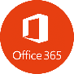

THE NEW WORLD of the “everywhere employee”
Work anywhere
Use every device
Access any application
Notes:
Employees and remote users that work from home but may occasionally work from office, employees that require secure access from any location and any device, and employees that access the internet and corporate applications that reside everywhere from the traditional datacenters to somewhere in the cloud

Slide 6




IN THE NEW WORLD WE WANT TO USE ANY DEVICE TO ACCESS ANY APPLICATION
WWW
Web
Home
SAAS
Cloud
CLOUD
On the go
DATACENTER
REMOTE DESKTOP
On-Premise
office
INTRANET
Notes:
With users working anywhere and using their mobile phones and laptops to access any application, your attack surface has never been wider. Especially since corporate apps these days are distributed across cloud, IaaS, and datacenters. Therefore Sensitive business data continually flows from BYOD devices to SaaS and cloud applications .

Slide 7
IN THE NEW WORLD WE WANT TO USE ANY DEVICE TO ACCESS ANY APPLICATION
WWW
Web
Home
IT IS WAY TOO COMPLEX!
SAAS
Secure Internet Browsing
Cloud
Remote Access
CLOUD
Secure Mobile
remote access
On the go
Prevent Zero-Day
Email Security
DATACENTER
Remote Desktop
Device Posture
NGAV
Prevent Phishing
REMOTE DESKTOP
On-Premise
Secure Endpoint
office
INTRANET
Notes:
To keep their corporate networks and sensitive data safe, organizations have no option but to recalibrate their security approach around remote users and access. Securing this hyper distributed workspace requires deploying endless cyber protections across devices, networks, access points, and applications. From endpoint and mobile security and email protection. From phishing and ransomware protection and remote access security, …. The list is long…

Slide 8













IN THE NEW WORLD WE WANT TO USE ANY DEVICE TO ACCESS ANY APPLICATION
WWW
Web
Home
TOO MANY SOLUTIONS…
SAAS
IT IS WAY TOO COMPLEX!
Cloud
CLOUD
On the go
DATACENTER
REMOTE DESKTOP
On-Premise
office
INTRANET
Notes:
However, stitching together point solutions may leave them with security gaps, fragmented visibility, complex management, and limited options to scale. To address these challenges, Check Point introduces Harmony…

Slide 9


CHECK POINT HARMONY UNIFIED SECURITY FOR USERS & ACCESS
Endpoint
Security
Cloud-delivered Network Security (SASE)
Clientless Zero Trust Access
WWW
1
2
3
Web
Home
SAAS
Cloud
CLOUD
On the go
DATACENTER
REMOTE DESKTOP
On-Premise
4
Email & Office Security
5
Secure Internet browsing
6
Mobile Security
office
INTRANET
Notes:
Check point Harmony, the industry’s first unified security solution for users, devices, and access. The solution consolidates 6 security products to provide complete protection for remote users. Check Point Harmony consolidates six security products:
1. Endpoint Protection (EPP)
2. Cloud-delivered Network Security (SASE)
3. Clientless Zero Trust Network Access (ZTNA)
4. Email & Office security
5. Secure Internet Browsing
6. Mobile security (also known as MTD- mobile threat defense )
The unified solution provides multi-layered protection for remote users against known and zero-day attacks and across all threat vectors. It protects users regardless of where they reside, the devices they use (company-owned/BYOD/Mobile /PC/Tablet), and the application they access (including the internet, SaaS applications, corporate applications in data centers or public clouds as well as Remote desktops, and the intranet).

Slide 10
HARMONIZE SECURITY FOR USERS & ACCESS HIGHEST LEVEL OF SECURITY
SIMPLE TO USE
Consolidated security products
SIMPLE TO MANAGE
User-centric security management
SIMPLE TO BUY
Unified commercial package
Notes:
Check Point Harmony consolidates six security products to provide uncompromised protection and simplicity for everyone. The solution protects remote devices and internet connections from the most sophisticated attacks while ensuring Zero-Trust Access to corporate applications – all in a single solution that is easy to use, manage and buy.
Check Point Harmony is easy to deploy with a simple per-user pricing model and is managed via a cloud service, enabling user-centric security policies to be applied across organizations’ environments.
Lets take a closer look into the entire Harmony product suite…

Slide 11

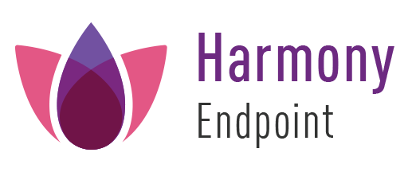

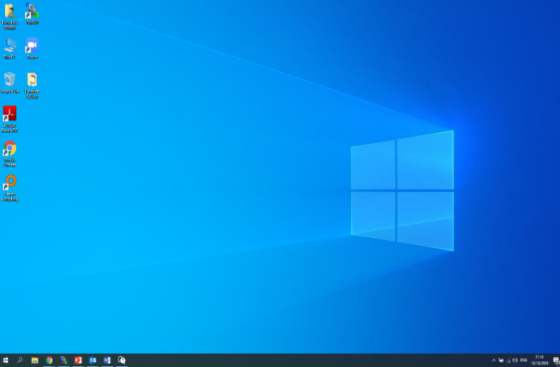
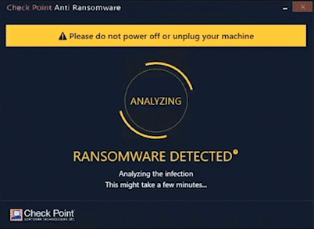

PROTECT THE ENDPOINT FROM ALL IMMINENT THREATS
01
Reducing the attack surface
02
Preventing attacks before they run
03
Runtime protection
Content Disarm & Reconstruction
Sandboxing
NGAV
Anti-malware
Zero-phishing
Anti-ransomware
Anti-bot
Anti-exploit
Behavioral Analysis
Host Firewall
Compliance
VPN
Web protection
Data Security
©2021 Check Point Software Technologies Ltd.
Notes:
Today more than ever, endpoint security plays a critical role in enabling your remote workforce.
Harmony Endpoint is a complete endpoint security solution built to protect the remote workforce from today’s complex threat landscape. It prevents the most imminent threats to the endpoint such as ransomware, phishing, or drive-by malware, while quickly minimizing breach impact with autonomous detection and response.
Multiple capabilities of Harmony Endpoint are provided in a way to ensure endpoints have multi-layered 360 degrees protection.
It all starts with reducing the attack surface with VPN, host firewall, data and web protection.
Once the surface is reduced, SBA leverages NGAV, anti-malware, anti-phishing, sandboxing and CDR technologies to prevent attacks before they start.
Yet, should some try and break through, SBA has a runtime protection in place to address and remediate those attacks with behavioral analysis, anti-ransomware, anti-exploit and other technologies in place.

Slide 12


CLOUD-DELIVERED SECURITY (SASE)
CONSOLIDATING 11 SECURITY SERVICES
Corporate
Email
IaaS
SaaS
Internet
Client-based
or
clientless
1
Next Generation Firewall
2
Advanced Threat Prevention
4
SaaS API
Secure Web
Gateway
3
7
Zero Trust Network Access (SDP)
5
Data Loss Prevention
10
Device posture & compliance
8
Email Security
9
Browser protection
6
Anti-Phishing
11
Web Application & API protection
©2021 Check Point Software Technologies Ltd.
12
Notes:
As a longstanding leader in the network security space, we already have strong capabilities spanning next generation firewall, secure web gateway, advanced threat prevention, DLP, and DNS security. All of these are robust field-proven technologies, which with Harmony, we’ve adapted to the cloud. We are now delivering them as a unified service.
Harmony Connect is redefining the Secure Access Service Edge (SASE) by making it easy to connect any user or branch to any resource, anywhere, without compromising security. Powered by 11 cloud-delivered security services to ensure secure connectivity at local-level speed.
Harmony connect offer the flexibility to choose between:
Agent based access- (VPN as a service) providing full access to corporate networks & applications.
Clientless access- let’s take a look in the next slide…

Slide 13


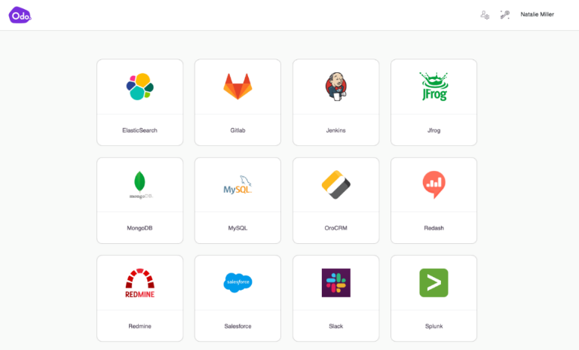
SECURE ACCESS TO CORPORATE APPLICATIONS
CLIENTLESS
ZERO TRUST NETWORK ACCESS (ZTNA)
Access any application | From any device | Using a web browser
As easy as connecting to SaaS!
©2021 Check Point Software Technologies Ltd.
13
Notes:
Harmony Connect provides also clientless access to corporate application.
Providing Employees & contractors secure and easy access to any corporate application (including web application, remote desktop, SSH remote terminal), simply from a web browser using any device (even mobile and home PC).
We’ve put a huge emphasis making remote access very user-friendly.
Everything is delivered from within the browser, through a personalized and intuitive user portal to access any application with zero trust network access principles. So user get access only to application they are authorized to use.

Slide 14

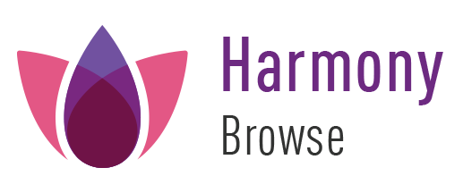



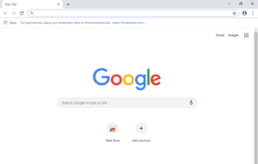




SECURE INTERNET BROWSING
Powered by Nano Agents
Secures any browser
Inspects 100% of SSL traffic
Prevents malware download
Prevents phishing
Prevents corporate password exposure
Notes:
employees require fast and secure web browsing to remain productive, no matter where they are. But the browsing habits of remote workers can pose a significant threat to businesses. That’s because the web is a perilous place, now, more than ever before. As I mentioned earlier, in the second quarter of 2020 alone there was a 3,900% increase in phishing attacks, according to Check Point threat researchers.
As a core component of Harmony, the new Harmony Browse uniquely provides secure, fast, and private web browsing by inspecting all SSL traffic directly on the endpoint without adding latency or re-routing traffic through a secure web service.
It blocks zero-day malware downloads, access to phishing websites and prevents the reuse of corporate passwords. It also keeps users’ browsing history private, ensuring compliance with data privacy regulations. Harmony Browse is easily deployed as a nano-agent in users’ browsers, and can be combined with any secure web gateway or endpoint security solution to enhance overall protection.

Slide 15

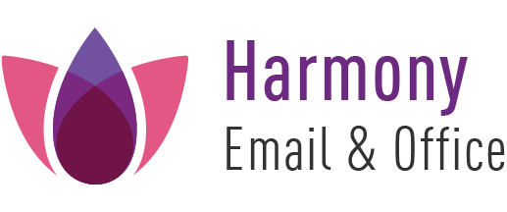

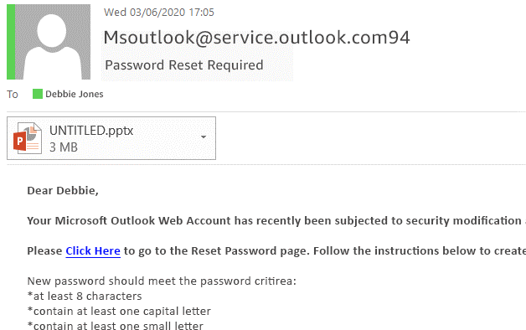
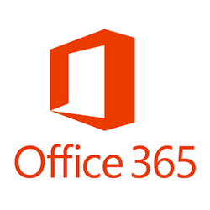
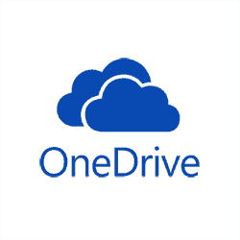
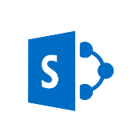

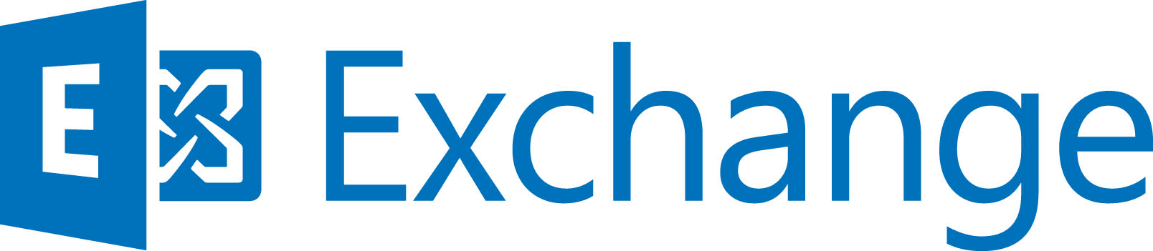
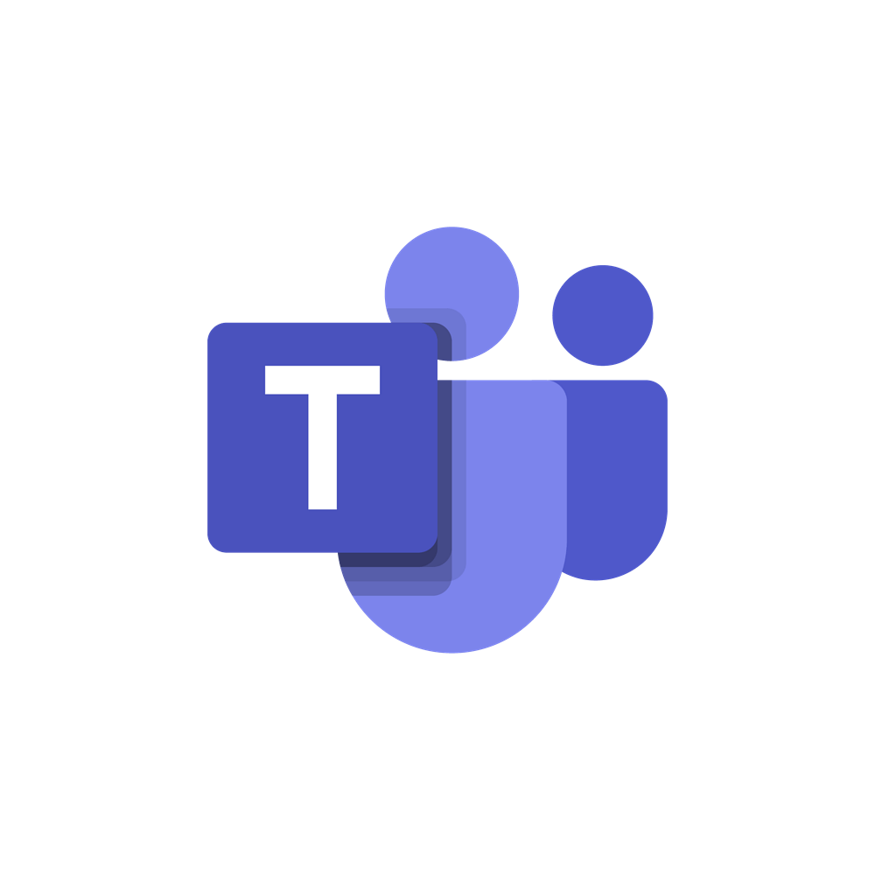
PROTECT USER MAILBOXES & PRODUCTIVITY APPS
SUSPICIOUS SENDER
MALICIOUS ATTACHMENT
c
MALICIOUS LINK
BODY TEXT SUSPICIOUS
©2021 Check Point Software Technologies Ltd.
15
Notes:
Email and collaboration apps have become the most fundamental tools for businesses these days. Not surprisingly, it is also one of the most exploited channels, with Business Email Compromise (BEC) attacks accounting for over 50% of losses caused by cybercrime*.
Harmony Email & Office protects your users from all imminent threats to cloud and on-prem mailboxes, as well as collaboration apps such as Teams, OneDrive, SharePoint and Google Drive.
- Prevent advance phishing and spear phishing attacks
- Block impersonation and Business Email Compromise attempts
- Block malicious attachments with malware, while providing sanitized version to the user within seconds.
- Protect users from threats hiding in malicious links
- Prevent malicious and unintentional data leakage
-

Slide 16
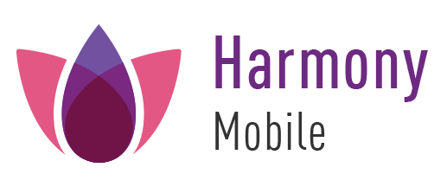
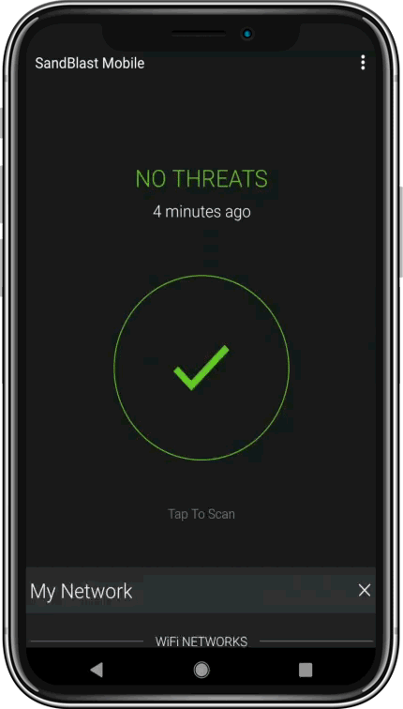
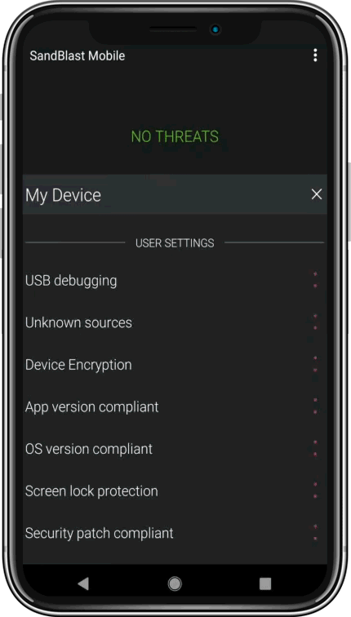
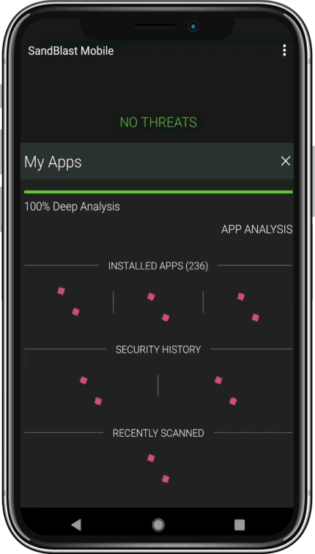

PROTECT CORPORATE DATA ACROSS ALL MOBILE ATTACK SURFACES
01
APPLICATIONS
Prevent the download of malicious apps
02
NETWORK
Prevent phishing, Man-in-the-Middle attacks, and more
03
DEVICE & OS
Real-time risk assessments detecting vulnerabilities and configuration changes
©2021 Check Point Software Technologies Ltd.
16
Notes:
Mobile security is a top concern for every company these days — and for a good reason. In the new normal, your remote workers increasingly access corporate data from their mobile devices. In fact, IDC expects that mobile workers will account for nearly 60% of the total U.S. workforce by the end of 2024.
Over the past year, researchers at Check Point have been observing a rise in the number of mobile-related attacks as well as entirely new attack methods such as sophisticated mobile ransomware, and MDMs getting weaponized to attack organizations.
Harmony Mobile I the market-leading threat defense solution. it Keeps your corporate data safe by securing employees’ mobile devices across all attack vectors: apps, network, and OS. It perfectly fits into your existing mobile environment, deploys and scales quickly, and protects devices without impacting user experience nor privacy.

Slide 17

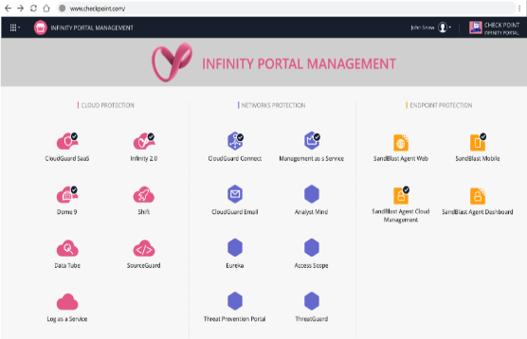




UNIFIED CLOUD-BASED MANAGEMENT DEPLOY, CONFIGURE AND MANAGE HARMONY FROM A SINGLE PORTAL
Cloud security
User & access security
Network security
Notes:
All capabilities are integrated and managed through Check Point’s Infinity Portal, which provides teams with unified policy management, consolidated security reports, event management and forensics for all Harmony solutions. It also includes the capabilities of Check Point’s CloudGuard platform for cloud-native security, and its Quantum network security. All logs and security events are stored in the Infinity Portal’s cloud-native big data platform, enabling vast amounts of data to be quickly searched and analyzed, providing unified visibility of malicious activity across Harmony solutions.

Slide 18






BEST ZERO-DAY PROTECTION POWERED BY THE WORLD’S MOST POWERFUL THREAT INTELLIGENCE AND 60+ SECURITY ENGINES
Automatic Remediation of Zero-Day Malware
3 Billion
Websites & Files
13 Million Files Emulated
150,000
Connected Networks
2,000
Zero-Day Files Detected Daily
Macro analyzer
Anomaly detection
Browser Extension Malicious JS
Family based signature
File Encryption Detection
Malware classifiers
Similarity models
Smart Backup and Restoration
Disc-Encryption Prevention
Dynamic Analysis of executables
Zero-phishing
Behavioral guard
Deep learning
Threat Extraction
File-less attack detection engine
Sandboxing / Threat Emulation
On-Device Anti-Bot engine
The industry’s best catch rate
Protecting against 25 out of NSA’s Top 25 Vulnerabilities
Being Exploited In the Wild
Behavior analysis
Machine-generated intelligence
Machine-generated signatures
Forensics report
Anti-Evasion engine
Metadata analyzer
Reputation service
60+
AI & traditional engines
Notes:
We make sure the Harmony protection is indeed complete and addresses even any emerging threats with all kinds of AI and traditional engines, facilitating the real-time data analysis. In addition to that, we leverage ThreatCloud, CheckPoint’s world’s most powerful threat intelligence, enriched by advanced predictive intelligence engines, data from hundreds of millions of sensors, cutting-edge research from Check Point Research, and external intelligence feed.
As a result, Harmony has an industry’s best catch rate just lately confirmed by the fact that protects against 25 out of 25 top vulnerabilities exploited in the wild and listed by NSA.
https://blog.checkpoint.com/2020/10/27/measuring-the-global-impact-of-the-nsas-top-25-vulnerabilities-being-exploited-in-the-wild/

Slide 19




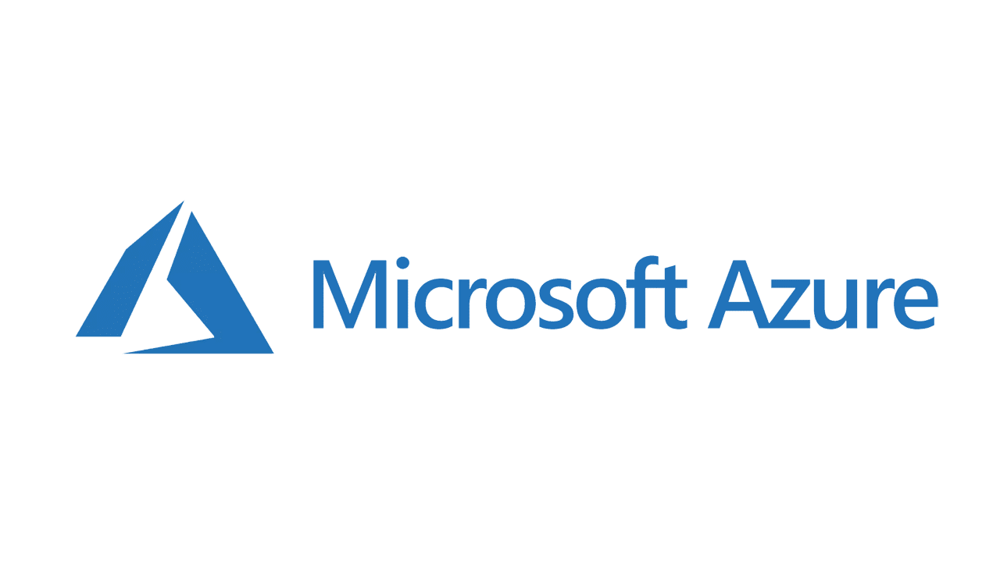






Harmony in Action

Slide 20




HARMONY: 360° USER PROTECTION AGAINST KNOWN AND ZERO-DAYS THREATS
Malware
Zero-days
Data leakage
Man-in-the-Middle
All threats
Phishing
Ransomware
Account takeover
Bot attacks
Malicious emails
Rogue networks
Theft or Loss
USB
All vectors
Malicious websites
Rogue applications
Human Error
ALL Devices
Company-owned and BYOD
Best prevention
60+ AI & traditional security engines
The industry’s most powerful threat intelligence
Notes:
With Check Point Harmony, your users get the same level of protection regardless of where they are, the applications they access, or the devices they use. Whether it’s a phishing website, a malicious email attachment, or zero-day ransomware, the solution protects them from cyber threats and across all attack vectors. Powered by revolutionary AI engines and the industry’s most extensive threat intelligence network, Harmony stops attacks before they happen.

Slide 21


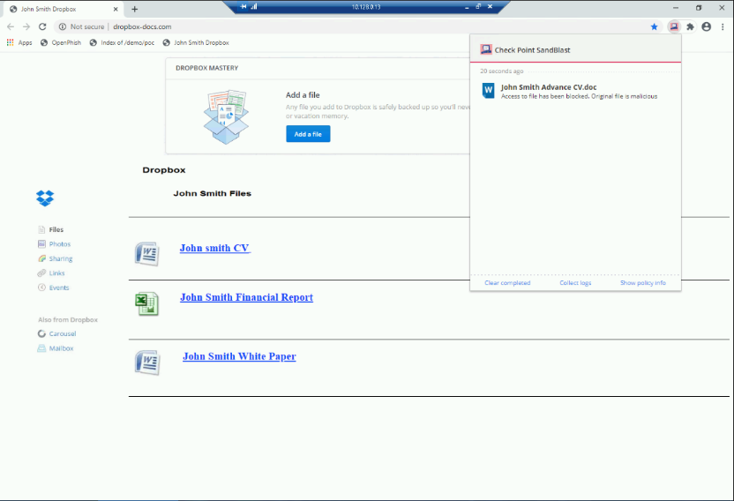
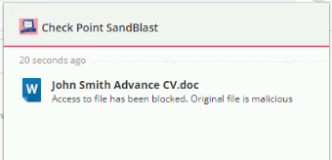

HARMONY: 360° MALWARE PROTECTION
Web downloads and links
Malware download
blocked
Malicious email attachments
File less attacks
Malicious files on USB
Malicious mobile apps
A sanitized file version is available
Notes:
Stephanie receives a malicious file containing malware which masquerades to a CV of someone in the name john smith…
Harmony Browse uses Check Point’s SandBlast, the industry-leading CDR technology, Threat Extraction, to deliver sanitized versions of web-downloaded files in seconds. In parallel, Check Point’s Threat Emulation technology analyses the files in a virtual sandbox to proactively prevent the zero-day, never seen before malicious file from reaching Stephanie.

Slide 22

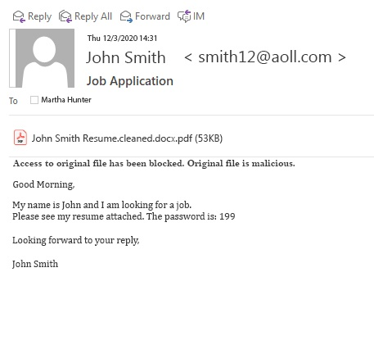
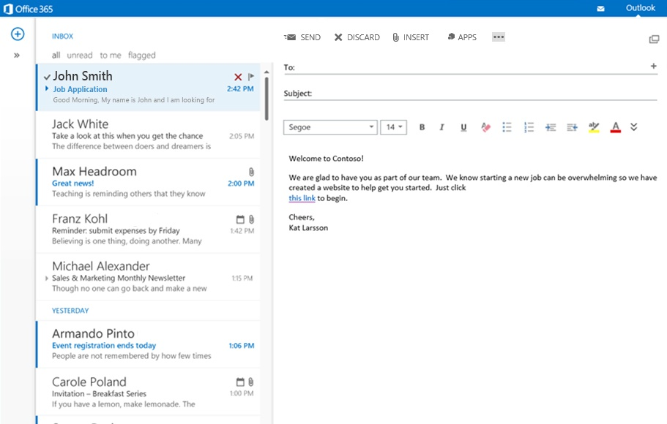
HARMONY: 360° MALWARE PROTECTION
Web downloads and links
Malicious email attachments
File less attacks
Malicious files on USB
Malicious mobile apps
Notes:
The same malicious file is sent to Stephanie's office 365 mail box.
Harmony Email & Office uses the same Check Point’s SandBlast technology to block the malicious content before it even reaches Stephanie’s mail box. All that while proving her a sanitized version of the email attachment within 2 seconds, after all potential threats were eliminated.

Slide 23
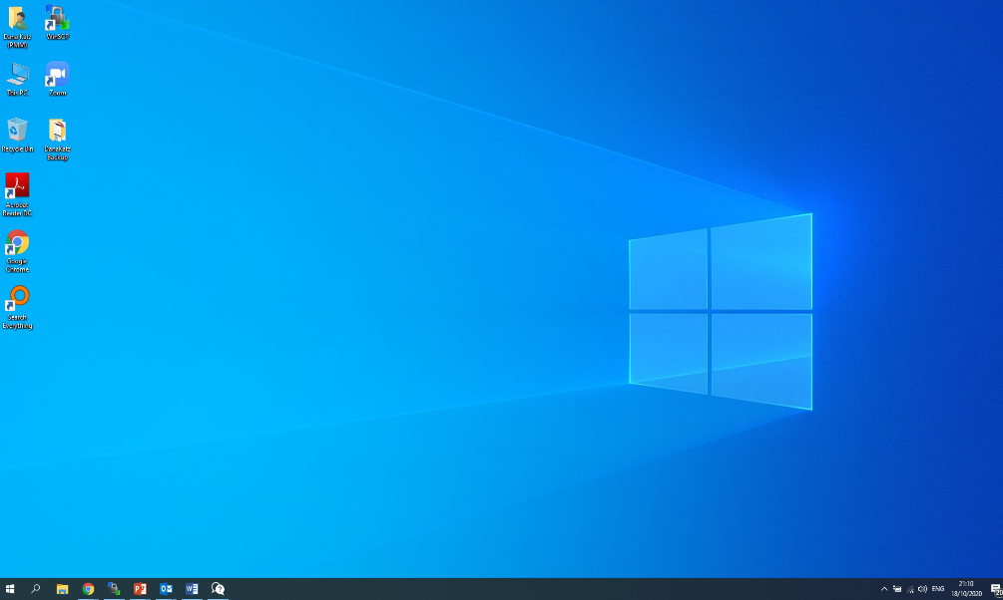
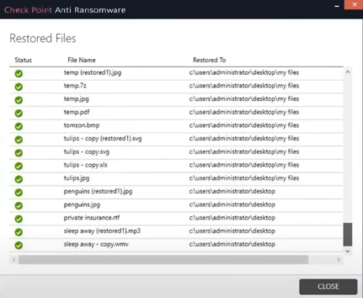
HARMONY: 360° MALWARE PROTECTION
Automated recovery
Safely restores ransomware-encrypted files
Web downloads and links
Malicious email attachments
On-device runtime protection
File less attacks
Malicious files on USB
Malicious mobile apps
Notes:
But even with the best prevention, it is important remember that a highly evasive zero-day malware can find its way to user’s devices. Whether through a USB stick containing malware, or even a sophisticated file less attack. We must have an excellent post breach detection and response strategy to protect user devices. To that end, Harmony Endpoint provides runtime protection against ransomware, malware.
It provides instant automated full remediation, even in offline mode.
Once an anomaly or malicious behavior is detected, Endpoint Behavioral Guard blocks and remediates the full attack chain without leaving malicious traces. Anti-Ransomware identifies ransomware behaviors such as encrypting files or attempts to compromise OS backups and safely restores ransomware-encrypted files automatically.

Slide 24
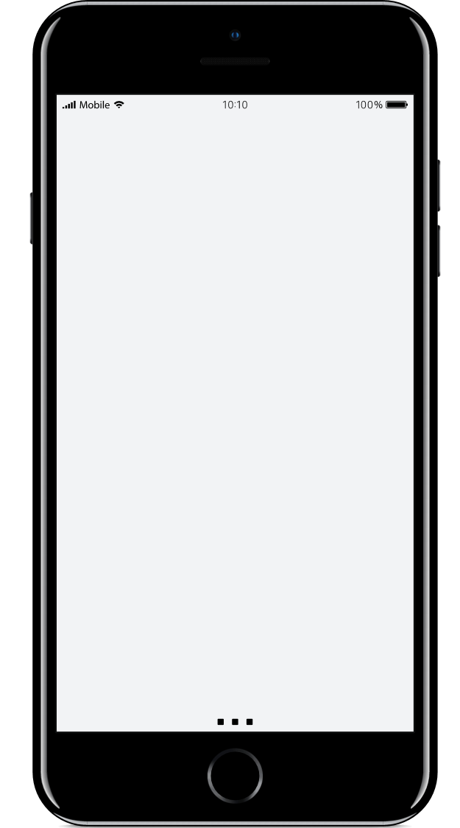
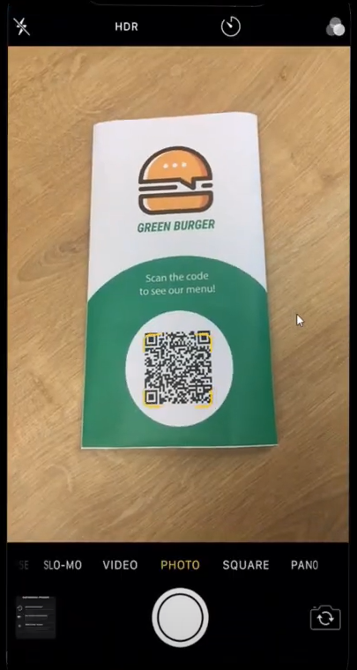
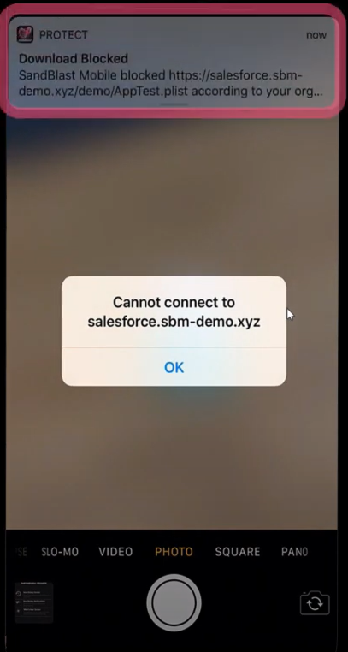
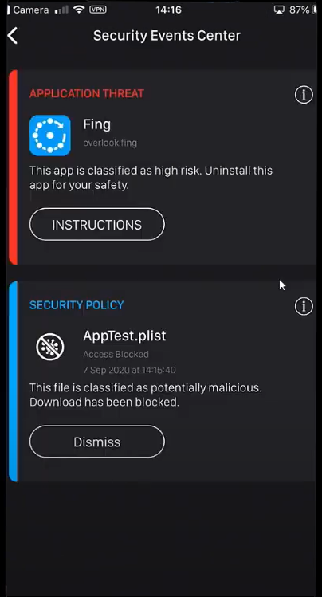
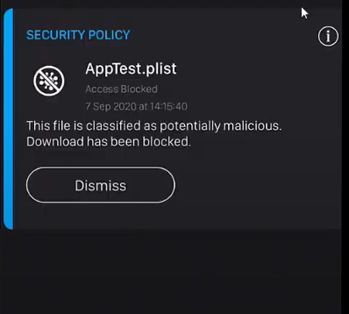

HARMONY: 360° MALWARE PROTECTION
User attempts to download an app using a QR code
Web downloads and links
Malicious email attachments
The download of the suspicious app is blocked
File less attacks
Malicious files on USB
Malicious mobile apps
Notes:
Malware can reach employees mobile devices as well through mobile Apps, especially when they are downloaded from untrusted sources.
In fact, according to our study, 46% of organizations have had at least one employee download a malicious mobile application which threatens their networks and data.
Let’s see how Harmony Mobile protect Stephanie’s mobile device from malicious mobile app.
Our user is now attempting to download a suspicious app from a QR code thinking it is the take away menu app for a restaurant.
<CLICK>
Harmony Mobile prevents the suspicious side-loading
<CLICK>
and shows the threat details to the user, while also showing the event details on the dashboard for admin’s review.

Slide 25



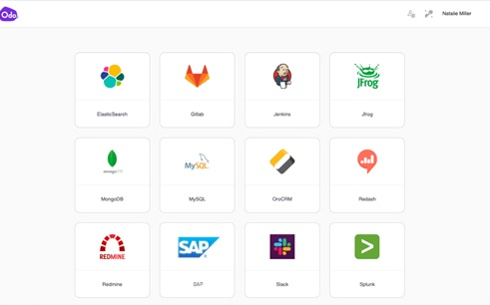
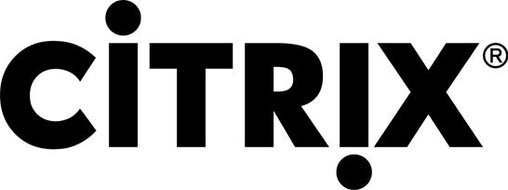

HARMONY: 360° MALWARE PROTECTION
BLOCK LATERAL MOVEMENT TO CORPORATE APPLICATIONS
Access any application:
Web (Http/s)
Remote Desktop (RDP)
Remote Admin (SSH)
Database (SQL)+
Managed and/or unmanaged device
Data Center
ACCESS BLOCKED
BASED ON DEVICE SECURITY POSTURE
IaaS
Notes:
With Harmony Stephanie get the easiest and most secure way to connect from any device, to any corporate application, SaaS or the internet.
She can access from a managed device, like her work laptop but have clientless access from her private smartphone, or private lap top.
Harmony connect allows to define and enforce Zero Trust Policy for all users to all applications, with granular rules to ensure Stephanie gain access only to apps she is authorized to use. And all via Intuitive portal from any browser.
And moreover…
If Stephanie's device is found to be compromised (infected with malware), harmony Connect will block access to the corporate application, to protect them from lateral malicious movement.

Slide 26
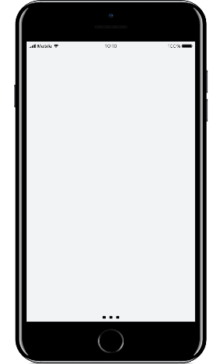
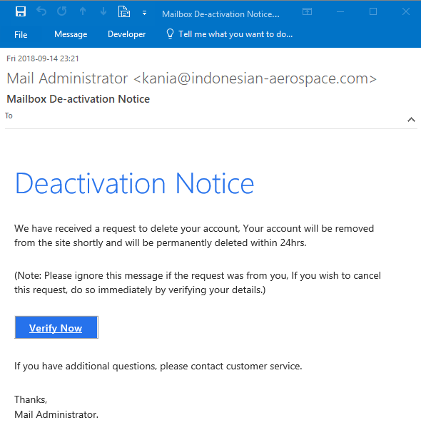
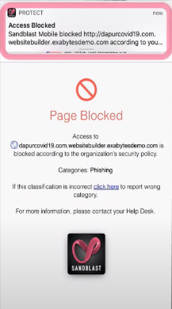

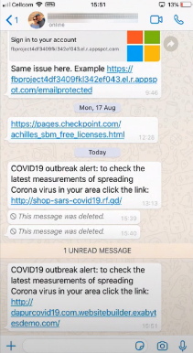

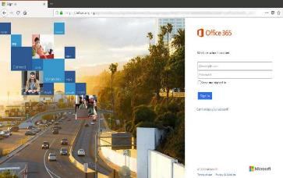
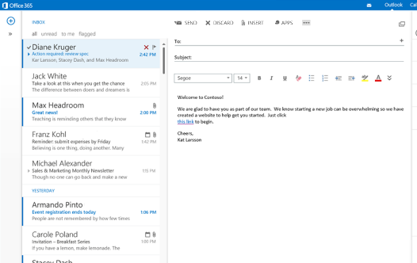

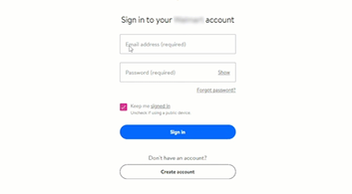
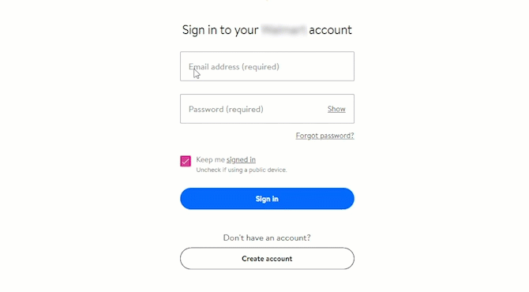
HARMONY: 360° PHISHING PROTECTION
Prevent access to phishing sites
Even those never seen before
Block phishing emails before they reach users
Prevent corporate password exposure
BLOCKED – Phishing Site
BLOCKED – Phishing Site
Notes:
And this is not just for malware. Stephanie also gets 360 protection from phishing attacks.

Slide 27





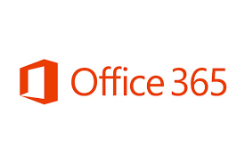



HARMONY: 360° DATA PROTECTION
SaaS
Email
Internet
Hard Disk Encryption
Port Protection
Ransomware Recovery
DATA AT REST
Data Leak Prevention (DLP)
DATA IN MOTION
Define DLP policies with hundreds of predefined and custom data types, including:
Social security number
Source code
Medical files
Credit card number
Bank account
Block access to corporate assets from infected/vulnerable devices
Notes:
Harmony also offers 360 data protection - protecting sensitive data wherever it resides, whether this data is at rest or in motion.
So if we bring it back to Stephanie on the picture here – Harmony ensures comprehensive data protection whatever devices or apps she uses
When the data is at rest - meaning- stored on the device, Harmony Endpoint minimizes the attack surface with full disk encryption and port protection. It also immediately recover ransomware encrypted data as we mentioned earlier.
Same with Mobile – Harmony Mobile blocks any access to corporate assets should the devices be vulnerable or be infected.
When it comes to data in motion:
Harmony Email and Office prevents data loss with a Data Leak Prevention solution for Office 365 and G Suite, that include email and productivity apps that may be used.
In addition, Harmony Connect prevents Stephanie from unintentionally leaking sensitive business data while she is browsing the internet or using SaaS application, as it encompass DLP service as one of its 11 cloud-based security services.
This is specifically beneficial to protect against Shadow IT usage – Harmony Connect can identify if users are using unauthorized SaaS account for example Slack (but the organization chose Teams) or Gmail (and the organization chose Office 365) and we can block them from sending sensitive data over these applications.

Slide 28
HARMONIZE SECURITY FOR USERS & ACCESS HIGHEST LEVEL OF SECURITY
SIMPLE TO USE
Consolidated security products
SIMPLE TO MANAGE
User-centric security management
SIMPLE TO BUY
Unified commercial package
Notes:
To summarize
Check Point Harmony provides unified security for users, devices and access, consolidating six products to ensure uncompromised security and simplicity for everyone. It protects devices and internet connections from the most sophisticated attacks while ensuring Zero-Trust Access to corporate applications - all in a single solution that is easy to use, manage and buy.
With Harmony, users get the same level of protection regardless of where they are, the applications they access, or devices they use. Whether it’s a phishing attempt, a malicious email attachment, or zero-day ransomware, the solution protects them from all cyber threats, across all attack vectors. Powered by AI engines and the industry’s most extensive threat intelligence network, Harmony stops attacks before they happen.

Slide 29
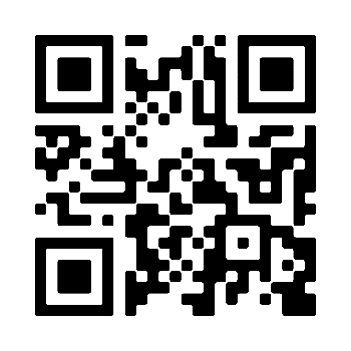
REGISTER FOR OUR UPCOMING WEBINARS
COMING UP NEXT:
March 17 | Tips for Adopting a SASE Approach to Network Security (Joint webinar with ESG analyst) Harmony Connect
March 24 | New Web Security Requirements: Keep Remote Workers Safe and Productive with Harmony Browse
March 31 | Harmony Endpoint - Modern Endpoint Protection: Best Practices to Secure Endpoints in 2021
April 7 | Harmony Mobile - Defending Against the Dangerous Wave of Mobile Threats
April 14 | Securing Mailboxes and Productivity Apps with Harmony Email & Office
Trouble scanning?
www.checkpoint.com/harmony/webinars
Notes:
Now that we introduced you to Harmony, we’re happy to invite you for a deep-dive into the products within the offering.
Starting next week we’ll be holding weekly sessions to talk about various Harmony products and the value they bring in-depth.
You can sign up to those sessions if you scan the QR code here or just visit the webpage www.checkpoint.com/harmony/webinars.
We encourage you to visit this page where you can also sign up for a demo and join us in the next few weeks for those webinars

Slide 30
Thank you

Slide 31
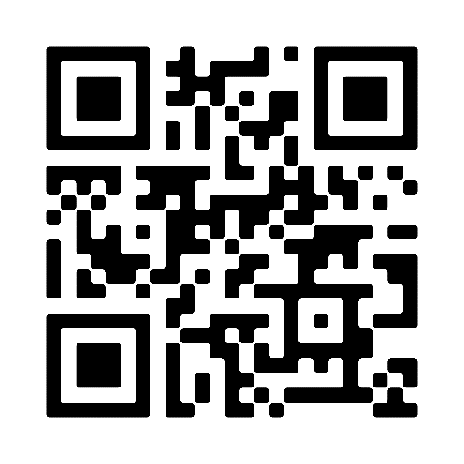
For a more personal understanding:
Register for a Demo
pages.checkpoint.com/harmony-demo.html

